Slide 1


Data Analysis: Project Budget to Actual.

Slide 2
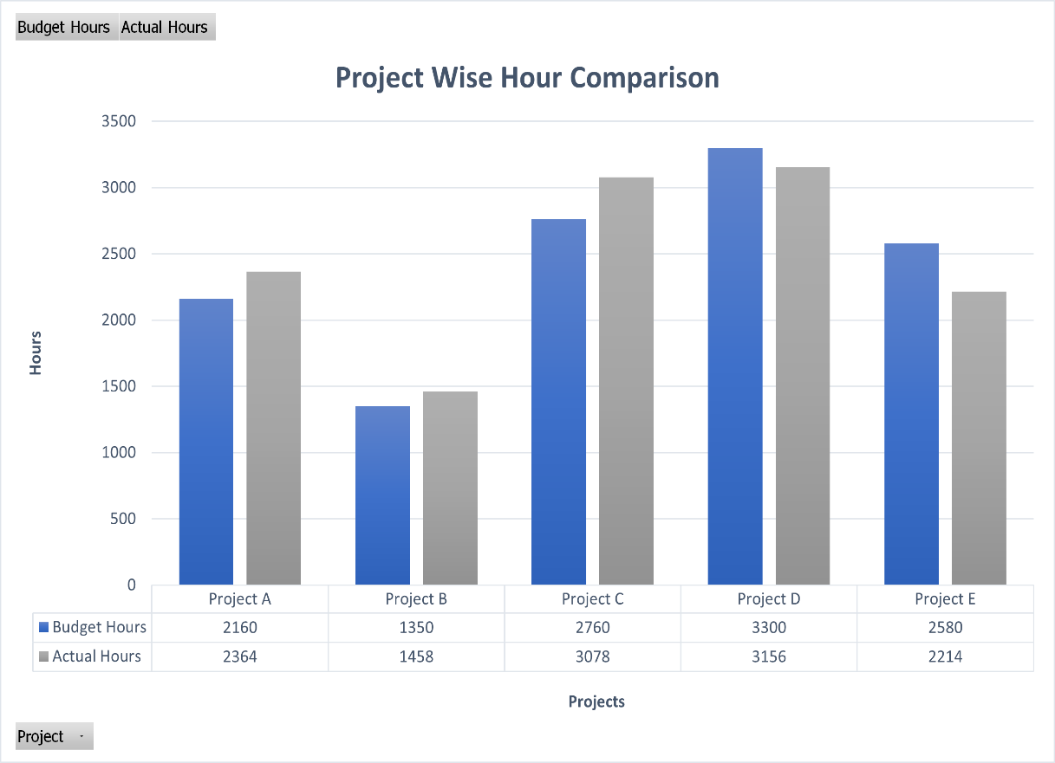
Observations:
• Project A, C, and D took more hours than their budgeted amount, while projects B and E took fewer hours.
• Project D had the largest budget, but it took more hours than budgeted, indicating potential inefficiencies in its management.
• Projects A and C also took more hours than budgeted, indicating that their scope or requirements may have been underestimated during planning.
• Project E took fewer hours than budgeted, which may indicate that its requirements were overestimated or that it was completed more efficiently than expected.
• Project B also took fewer hours than budgeted, but the difference was not as significant as in Project E.
• Overall, the projects seemed to have a variance in their performance compared to their budget, which could indicate the need for better planning or more effective management.

Slide 3
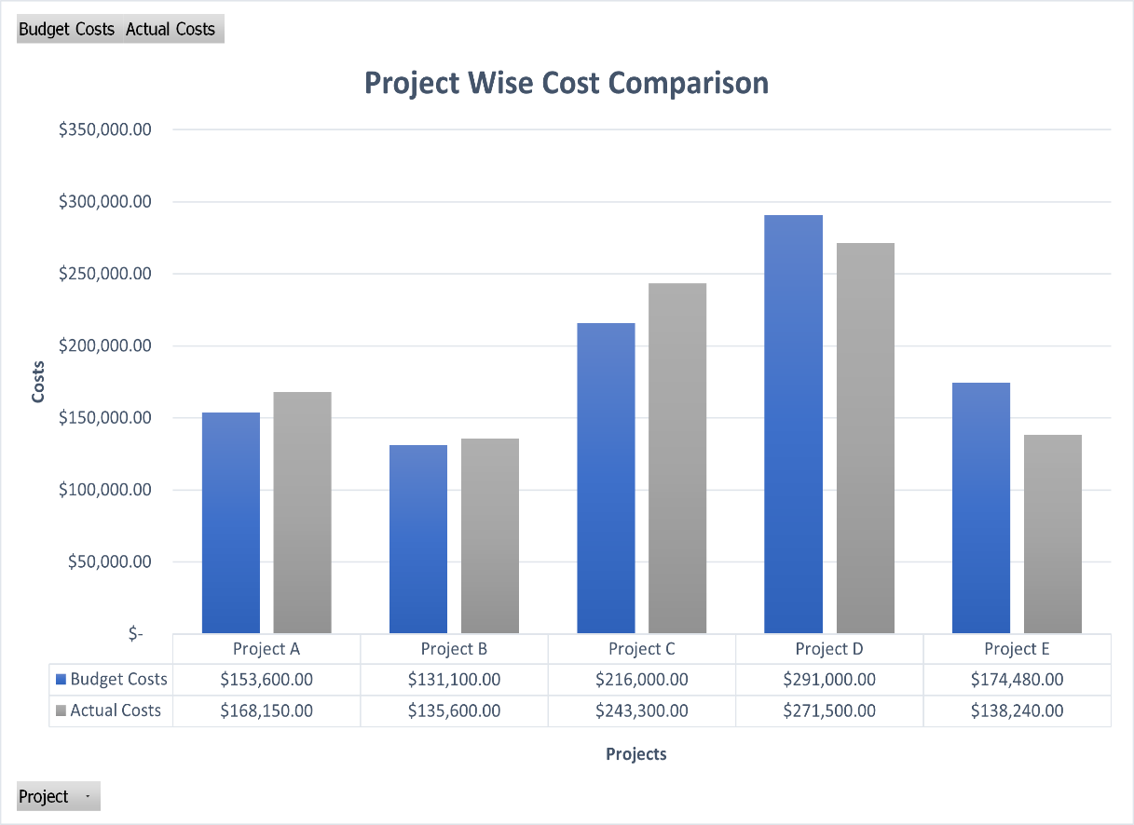
Observations:
• Project A had a budget of USD 153,600 and actually took USD 168,150, indicating a cost overrun of 9.47%. This means that the actual cost of this project exceeded the budgeted cost, which could lead to financial challenges.
• Project B had a budget of USD 131,100 and actually took USD 135,600, indicating a cost overrun of 3.43%. Similar to project A, the actual cost of this project exceeded the budgeted cost, leading to potential financial challenges.
• Project C had a budget of USD 216,000 and actually took USD 243,300, indicating a cost overrun of 12.65%. This means that the actual cost of this project exceeded the budgeted cost by a significant margin, which could lead to substantial financial challenges.
• Project D had a budget of USD 291,000 and actually took USD 271,500, indicating a cost savings of 6.69%. This means that the actual cost of this project was less than the budgeted cost, resulting in cost savings.
• Project E had a budget of USD 174,480 and actually took USD 138,240, indicating a cost savings of 20.77%. This means that the actual cost of this project was significantly less than the budgeted cost, resulting in substantial cost savings.

Slide 4
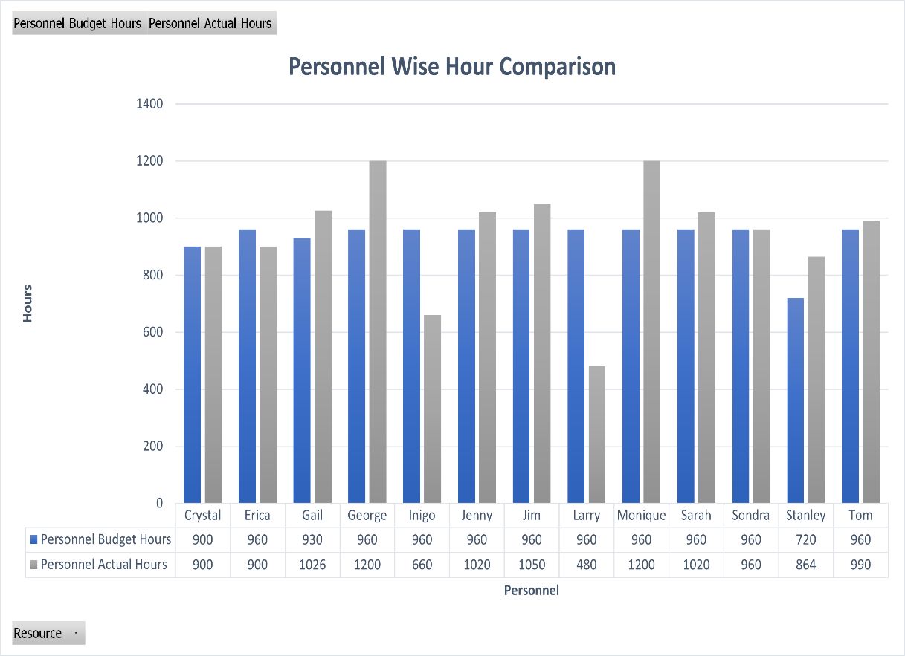
Observations:
• Crystal had a budget of 900 hours, and she worked for 900 hours, indicating that she utilized her budgeted hours entirely.
• Erica had a budget of 960 hours, but she worked only 900 hours, indicating that she had 6.25% underutilization of her budgeted hours.
• Gail had a budget of 930 hours, but she worked for 1026 hours, indicating that she had 10.32% overutilization of her budgeted hours. This means that Gail exceeded her budgeted hours, which could lead to potential financial challenges.
• George had a budget of 960 hours, but he worked for 1200 hours, indicating that he had 25% overutilization of his budgeted hours. This means that George exceeded his budgeted hours significantly, which could lead to substantial financial challenges.
• Inigo had a budget of 960 hours, but he worked for 660 hours, indicating that he had 31.25% underutilization of his budgeted hours.
• Jenny had a budget of 960 hours, and she worked for 1020 hours, indicating that she utilized her budgeted hours entirely.
• Jim had a budget of 960 hours, and he worked for 1050 hours, indicating that he utilized his budgeted hours entirely.
• Larry had a budget of 960 hours, but he worked for 480 hours, indicating that he had 50% underutilization of his budgeted hours.
• Monique had a budget of 960 hours, but she worked for 1200 hours, indicating that she had 25% overutilization of her budgeted hours.
• Sarah had a budget of 960 hours, and she worked for 1020 hours, indicating that she utilized her budgeted hours entirely.
• Sondra had a budget of 960 hours, and she worked for 960 hours, indicating that she utilized her budgeted hours entirely.
• Stanley had a budget of 720 hours, but he worked for 864 hours, indicating that he had 20% overutilization of his budgeted hours. This means that Stanley exceeded his budgeted hours, which could lead to potential financial challenges.
• Tom had a budget of 960 hours, and he worked for 990 hours, indicating that he utilized his budgeted hours entirely.

Slide 5
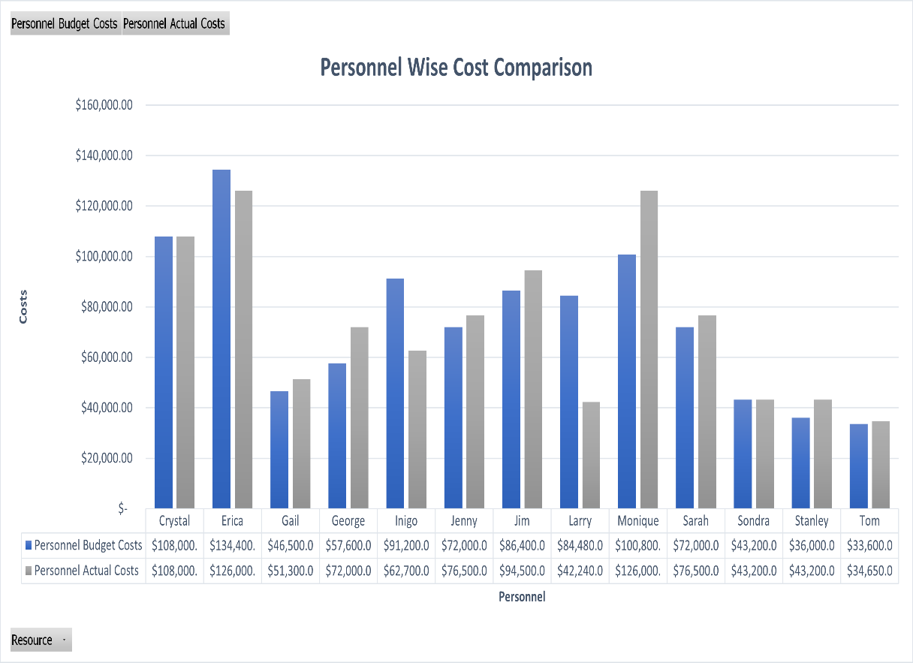
Observations:
• Crystal stayed on budget with both budget and actual cost being $108,000.00.
• Erica was slightly under budget with actual cost being $126,000.00 compared to budget cost of $134,400.00.
• Gail went over budget with actual cost being $51,300.00 compared to budget cost of $46,500.00.
• George went over budget with actual cost being $72,000.00 compared to budget cost of $57,600.00.
• Inigo went over budget with actual cost being $62,700.00 compared to budget cost of $91,200.00.
• Jenny went slightly over budget with actual cost being $76,500.00 compared to budget cost of $72,000.00.
• Jim went over budget with actual cost being $94,500.00 compared to budget cost of $86,400.00.
• Larry went significantly under budget with actual cost being $42,240.00 compared to budget cost of $84,480.00.
• Monique went over budget with actual cost being $126,000.00 compared to budget cost of $100,800.00.
• Sarah went slightly over budget with actual cost being $76,500.00 compared to budget cost of $72,000.00.
• Sondra stayed on budget with both budget and actual cost being $43,200.00.
• Stanley went slightly over budget with actual cost being $43,200.00 compared to budget cost of $36,000.00.
• Tom went slightly over budget with actual cost being $34,650.00 compared to budget cost of $33,600.00.

Slide 6
Observations and Key Insights
Project D had the largest budget but took more hours than budgeted, which may indicate inefficiencies in its management.
Project A, C, and D took more hours than budgeted, indicating potential scope or requirement underestimation during planning.
Project E took fewer hours than budgeted, which could indicate overestimation or efficient execution.
Projects B and E took fewer hours than budgeted, indicating potential efficiency in execution.
The projects seemed to have a variance in their performance compared to their budget, which could indicate the need for better planning or more effective management.
The budgeted and actual hours for Project A showed a variance of 186 hours.
The budgeted and actual hours for Project B showed a variance of 108 hours.
The budgeted and actual hours for Project C showed a variance of 318 hours.
The budgeted and actual hours for Project D showed a variance of 144 hours.
The budgeted and actual hours for Project E showed a variance of 366 hours.
Personnel Gail and Monique exceeded their budgeted hours, indicating potential inefficiencies in management or planning.
Personnel Inigo and Larry completed fewer hours than their budgeted amount, indicating potential efficiency in their work.
Personnel Tom completed 30 fewer hours than budgeted, but the difference was not significant.
Personnel George completed significantly more hours than budgeted, which could indicate potential inefficiencies in his work or management.
Personnel Crystal and Sondra completed their budgeted hours, indicating efficient execution of their tasks.
These insights suggest that while some projects and personnel exceeded their budgeted hours and costs, others fell short, and there was an overall increase in both hours and costs for the projects and personnel. These insights may be used to inform future budgeting and planning decisions for the company.

